Slide 1

Focus Group Report
By: Selam, Indeya, Mohammad, Colin, Kristina

Slide 2
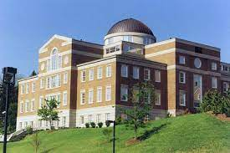
Introduction
Location: Fintel Library
Demographics:
6 participants
2 Seniors, 2 Sophomores, one Junior, one Freshman
4 females and 2 males
Moderator – Mohammad
Observers - Everyone else

Slide 3

Discussion Guide Answers:

Slide 4
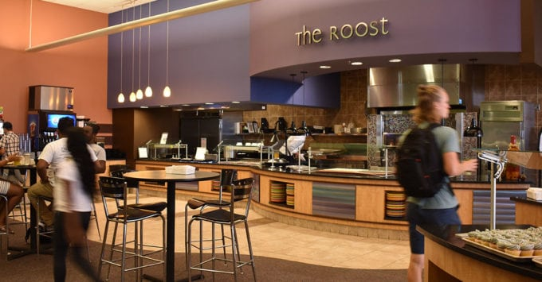
Dining Roanoke College
Everyone dines on campus
Rooneys is popular for breakfast
Commons is popular for dinner
Quality at Freshens is not great
Mobile ordering has some issues
Prefer Chik-Fil-A, Starbucks on campus
Mobile ordering options

Slide 5
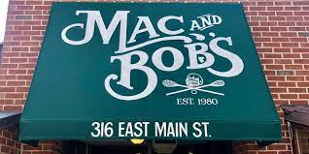
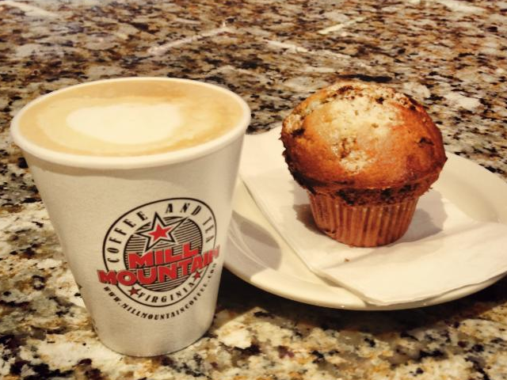
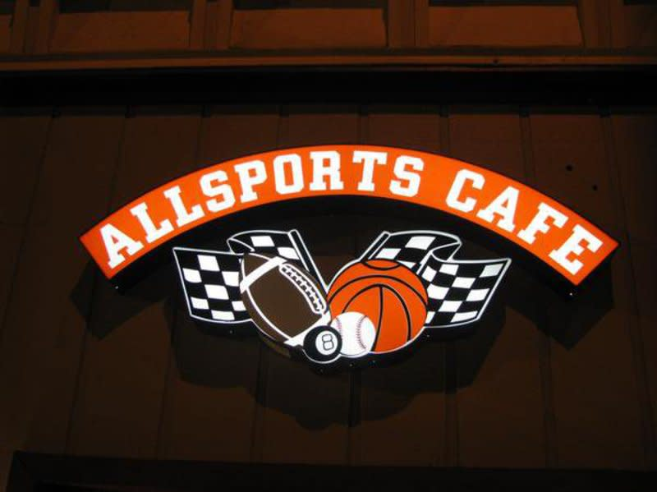
Dining Salem
Money spent depends- $30, $35, $60
Mostly on weekends
Locally on main street, close to campus
Better breakfast options are preferred

Slide 6
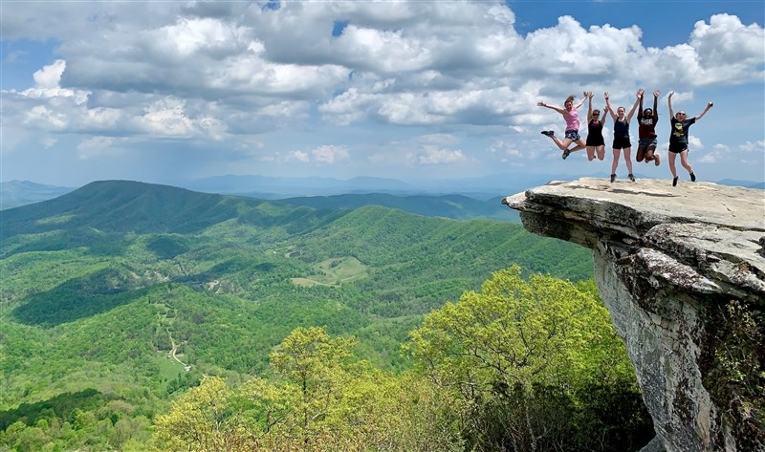
Entertainment Roanoke College
Depends on what day, prefer weekends
BINGO, Silent Disco
Like to see Spoken Poetry and weekend events
Like to see bigger events like Prez Ball
Fall concert to have popular artists perform

Slide 7
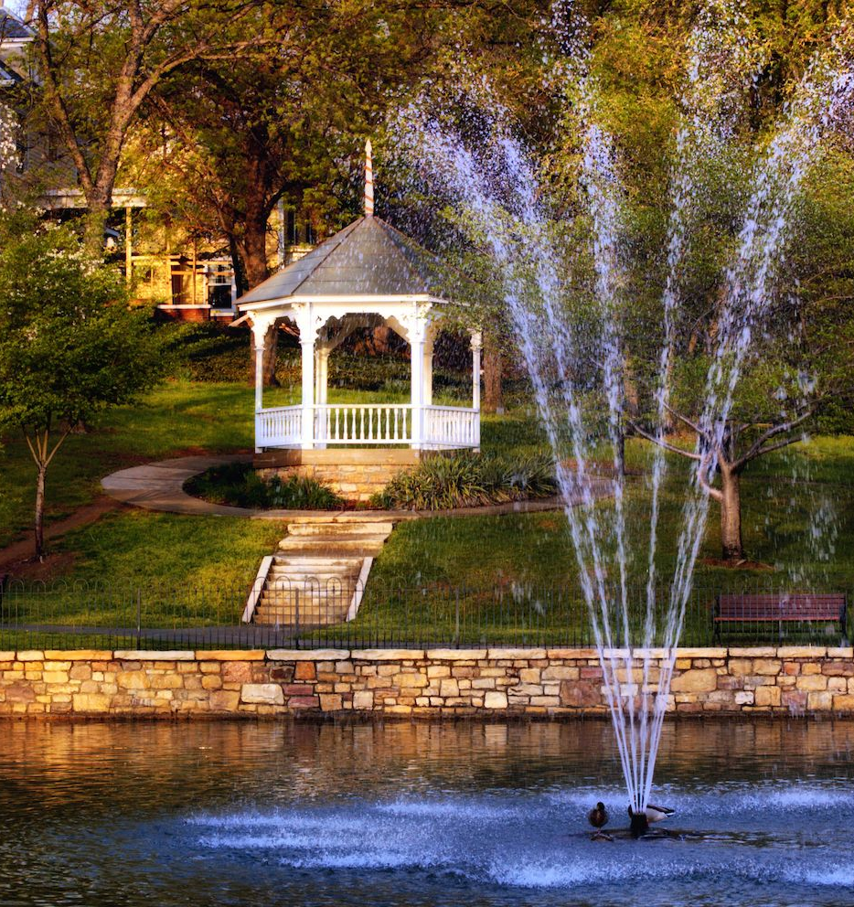
Entertainment Salem
Duck Pond and Thunder Valley
Satisfaction is not high: across town
Recommendations include golf club and club

Slide 8

Observations
Gloomy and heavy air
Agreement between respondents
Cooperative
Respondent does not eat on campus

Slide 9
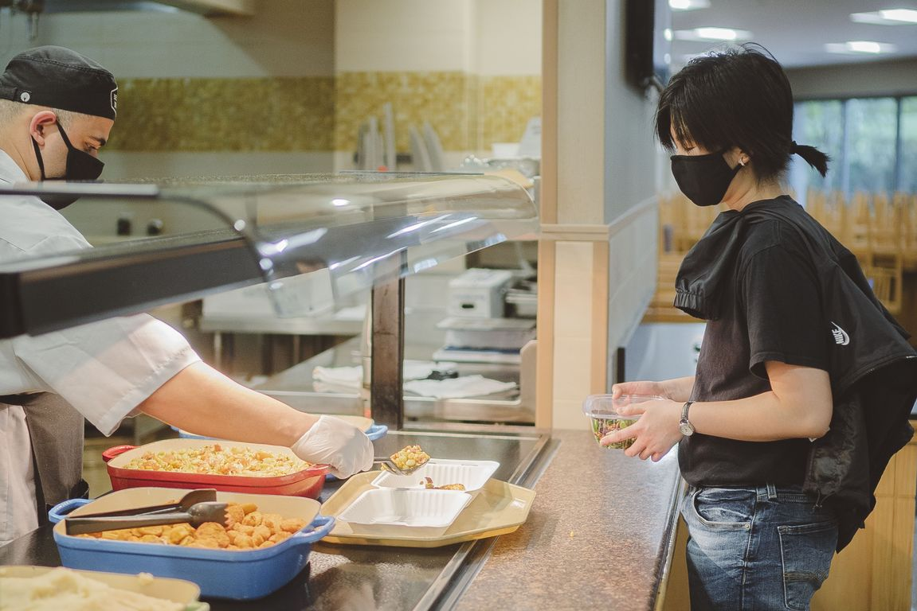
Overall Findings
Covid-19’s impact on dining conditions in RC
Commons had the highest rating comparatively
Upperclassmen had the highest satisfaction both in entertainment & dining
Entertainment had higher satisfaction both on & off-campus compared to dining
Inconvenience as the main issue for off-campus entertainment
Inconvenient timing as the main issue for on-campus events

Slide 10

Thank You For Your Attention!

